Slide 1
WELCOME
Class: B.Com – Part-1
Subject: Financial Accounting
Topic – Financial Statement Of Non Trading Organization:
A. Receipt And Payment Account
Prepared By
Dr. SHAHID IQBAL
Guest Faculty
Marwari College, Darbhanga,
Mobile no. and whatsup no. : 7004160257
Email ID: shahidlnmu@gmail.Com

Slide 2
Non Trading Organization: A Glimpses Of Their Final Account
Not-for-Profit Organisations are organisations which are set up for the welfare of the society or for the promotion of art and culture in the society. Normally, these organisations do not undertake any business activity, and are managed by trustees who are fully accountable to their members and the society for the utilization of the funds raised for meeting the objectives of the oorganization. Hence, they also have to maintain proper accounts and prepare the financial statement which take the form of following at the end of every accounting period (normally a financial year):
A. Receipt and Payment Account;
B. Income and Expenditure Account; and
C. Balance Sheet

Slide 3
Meaning Of Receipts and Payments Account:
“A receipt and payment account is a summarized cash book for a given period". "This is a summary of the cash transactions as in the cash book”. Non-profit organizations prepare receipt and payment account at the end of the year. With the help of this account and some additional information, we prepare income and expenditure account to disclose the true results of non-profit organizations. So, we can say receipts and payments account is a summary of actual cash receipts and payments extracted from the cash book over a certain period. All cash received and paid during the period whether capital or revenue is included in this account. The receipts are entered on the debit side, that in on the same side as that on which they appear in the cash book.
Thus we can say that receipts and payments account summarizes receipts and payments made by a non-trading concern during a particular period of time (usually one year). Its is used to prepare income and expenditure account of non-trading concerns.

Slide 4
Features Of Receipts and Payments Account:
It is also known as Cash Book Summary for the Not-for-Profit organizations because it records all the cash and cash equivalents like cheques transactions throughout the year.
It starts with beginning cash and bank balance and ends with ending cash and bank balance.
This account shows cash transactions of both capital and revenue nature.
Mostly it shows a debit balance. In the exceptional case of overdraft balance, its net balance may be credit.
The concern prepares it on the last day of the accounting year.
Double Entry bookkeeping system does not apply to this account since it is a summary of transactions which are already recorded in the Cash Book.
It does not involve transactions which do not include cash or bank items.

Slide 5
Advantages Of Receipts and Payments Account:
Following are the advantages of Receipts and Payments Account:
Total, receipts and total payments under different heads can be seen at a glance.
Verification of Cash Book can be done with it.
It provides classified records of different heads of receipts and payments.
It provides ready-made data for the preparation of Income and Expenditure Account

Slide 6
Limitations Of Receipts and Payments Account:
The receipts and payments accounts suffers from the following limitations:
Receipts and payments account does not differentiate capital and revenue expenses and incomes.
Receipts and payments account fails to show expenses and incomes on accrual basis.
Receipts and payments account fails to show surplus and deficiency.
Receipts and payments account fails to show non-cash transactions such as depreciation of fixed assets, pilferage etc.

Slide 7
Preparation Of Receipts And Payments Account:
As we know, we prepare Receipts and Payment Account with all the cash receipts and cash payments for the whole year. We determine the net result of cash receipts and cash payments of a fixed time through this account. The left-hand side of this account is known as “Receipts” and right-hand side of this account is known as “Payments”. All cash receipts are recorded on the left-hand side, while all cash payments are recorded on the right-hand side and are arranged in a classified form.
Following steps are taken in the preparation of receipts and payment account -
We start with taking opening balances of cash in hand and cash at bank and enter them on the debit side. (if there is bank overdraft at the beginning, we enter the same on credit side).

Slide 8
Now, we enter the total amounts of all receipts on the debit side and total amount of all payments on credit side (whether capital or revenue) and whether they are of past, current and future periods.
We do not include the incomes or expenses that do not involve the inflow or outflow of cash.
Now, we will find the difference between the total of the debit side and the total of the credit side of the account, the amount so found will be the closing balance of cash or bank.
In case, if the credit side is more than the debit side, the amount will be debited as bank overdraft and we will close the account.

Slide 9
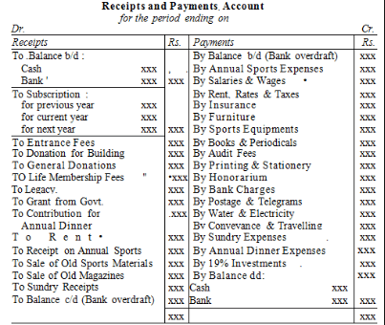
Specimen Of Receipts And Payment Account:

Slide 10
THANK YOU

